Slide 1
Age Prediction
By Nicholas Fong
COEN 345
6/7/18

Slide 2
Overview
What is my project
Why I chose my topic
Background Research
How I did my Project
Results
Conclusions
Next Steps

Slide 3
What Is My Topic
Big Picture: Using convolutional neural networks for regression
More Specifically: Predicting someone’s age from their face
Domain: Males between the age of 1 and 90 inclusive

Slide 4
Why I Chose My Topic
The vast majority of research in the field of computer vision relates to classification
Regression is something that is almost completely neglected in the field
I like to take the road less traveled
I couldn’t find any image regression datasets online
Predicting someone’s age is a feasible task for which I can make my own dataset
Since I was building my own dataset, didn’t want NSFW photos

Slide 5
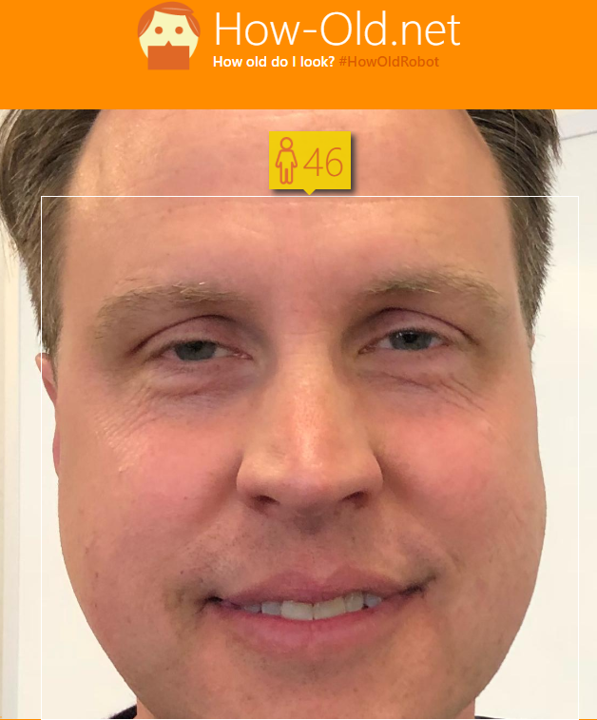
Background
In the realm of computer vision using regression, predicting someone’s age is the most common topic
Microsoft has an existing tool to predict your age (how-old.net)

Slide 6
Implementation
Building a web scraper
Downloading images
Realizing the need for automation
Cropping out just the faces
Deleting images that were too small
Manually deleting images that were incorrectly tagged
Building the CNN
Training the CNN
Evaluating the results

Slide 7
Building the Web Scraper
Tutorial released by Adrian 2 months ago
Utilizes Bing’s API
3000 image max?
Downloading the images (with many failed downloads)

Slide 8
Realizing the need for automation
At first, I was deleting irrelevant images 1 at a time
Incorrectly named images
Images not of men
Images that were too small
Images that were labeled incorrectly
Images with the person in the background (lots of noise)
Images that were duplicated
Images with multiple people of varying ages
Images with really low quality
There has to be a better way!

Slide 9
Cleaning the Dataset
SNFaceCrop automatically crops out just the faces of images in batch
Fixed most of the tediousness, but still had to manually verify the data afterwards
Out of the 10,800 photos I tried downloading, I was left with 4441 photos of decent quality to train on

Slide 10
Building the CNN
Preprocess the data, scaling images down to 128x128x3
[CONV => ELU => BN => POOL => DO] x 3 => FC => DO => FC
Get a little bit of all the useful parts of a CNN
ELU rather than ReLU / tanh
DO ratio of 0.25, expect the last one at 0.5
Pooling standard max pooling in a 2x2 square

Slide 11
Training the CNN
Optimizer model of Adadelta because SGD was blowing up
Adadelta is an adaptive optimizer that adjusts the learning rate without being very sensitive to initial conditions
Data optimizer to increase the data to train on
Each epoch took ~ half an hour
Ran ~ 100 epochs over the course of a week
Towards the end of training, validation error started increasing, indicating the model had converged
Saved the best model each night
Validation error based on L2 norm

Slide 12
Evaluating the results
Average L1 norm of 10 years
Average L2 norm of 175 years²

Slide 13







Demo
Face0
Face1
Face2
Face3
Face4
Face5
Face6

Slide 14
Demo

Slide 15
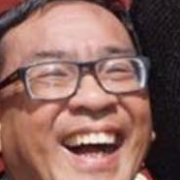
Demo
Predicted: 69.2
Actual: 62

Slide 16
Conclusions
CNNs can be used in regression effectively
Predicting someone’s age, a task even us humans struggle with, can be accomplished with reasonable accuracy by a CNN

Slide 17
Next Steps
Try changing hyperparameters
CNN structure
Dropout probabilities
Optimization algorithm
Get more data
Make this a polished app for $$$

Slide 18
Thanks for listening!
Any questions?

